Slide 1
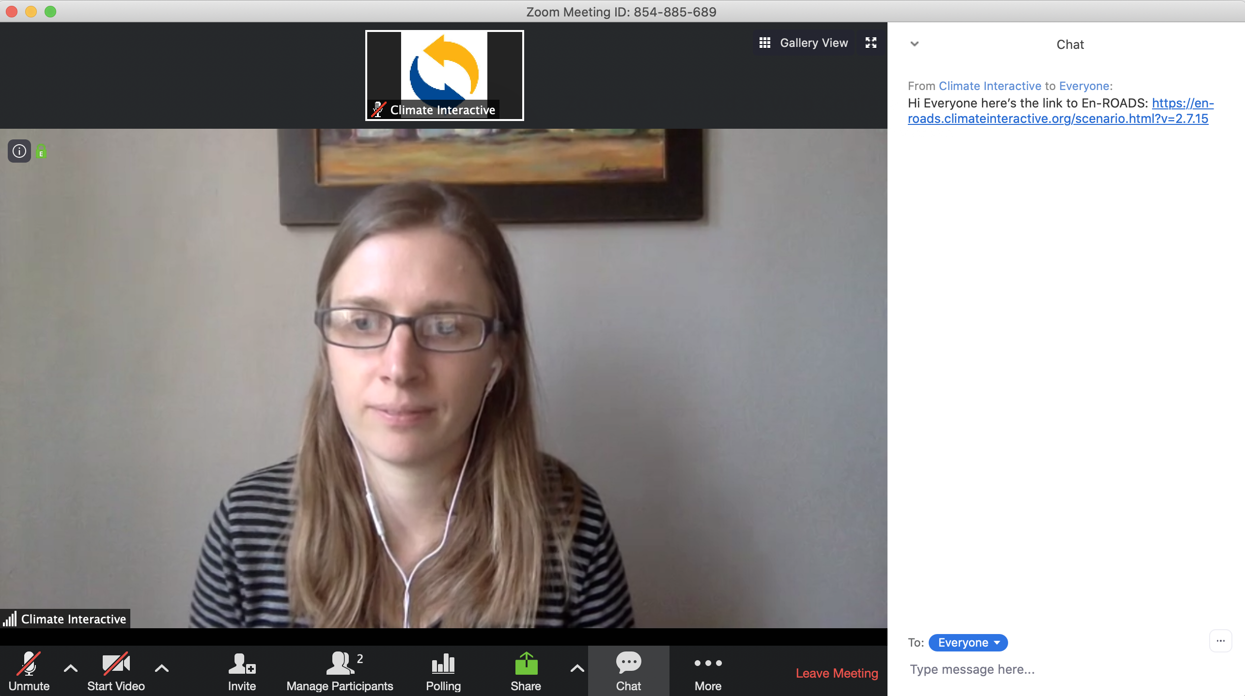
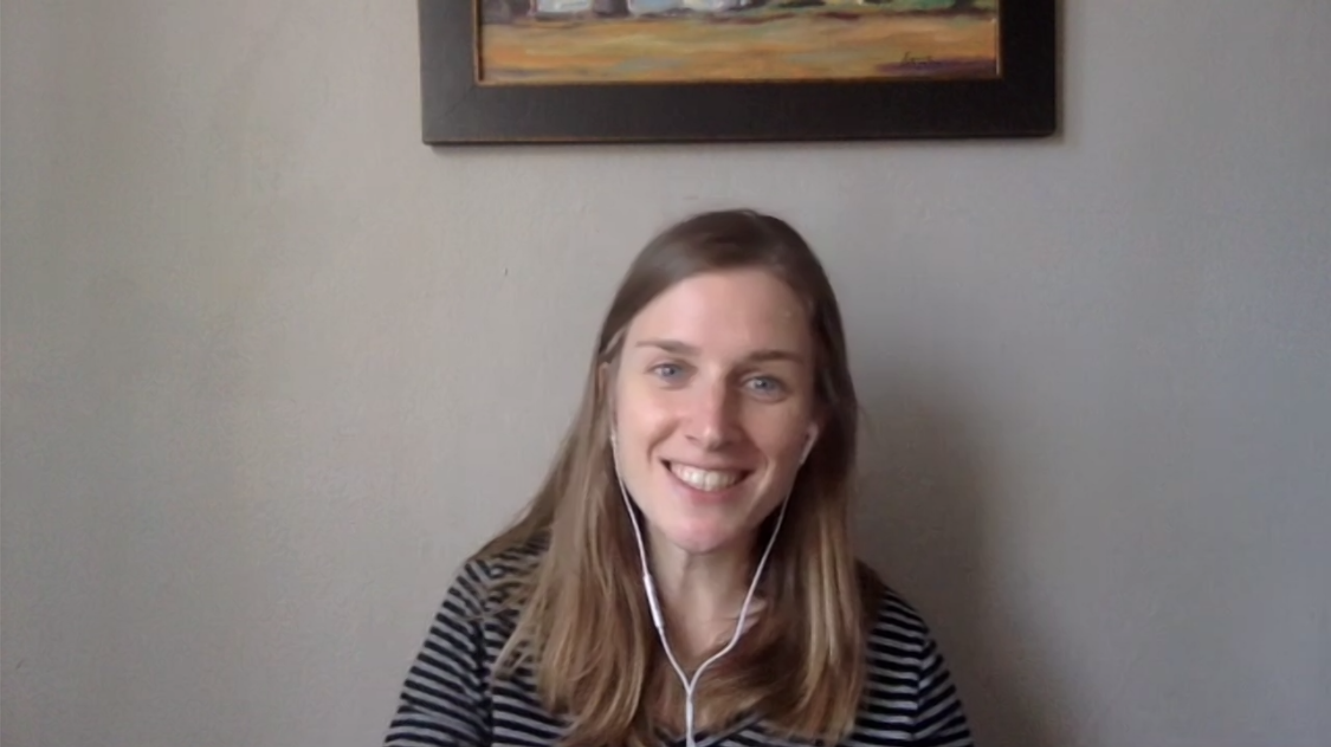
Zoom – “Main Room” Interface
Check the chat box for important messages and links from the host(s) and participants
Control your webcam and audio here
Use this to write messages to the entire group, or to specific participants
Click the chat button to prompt the “chat box”

Slide 2
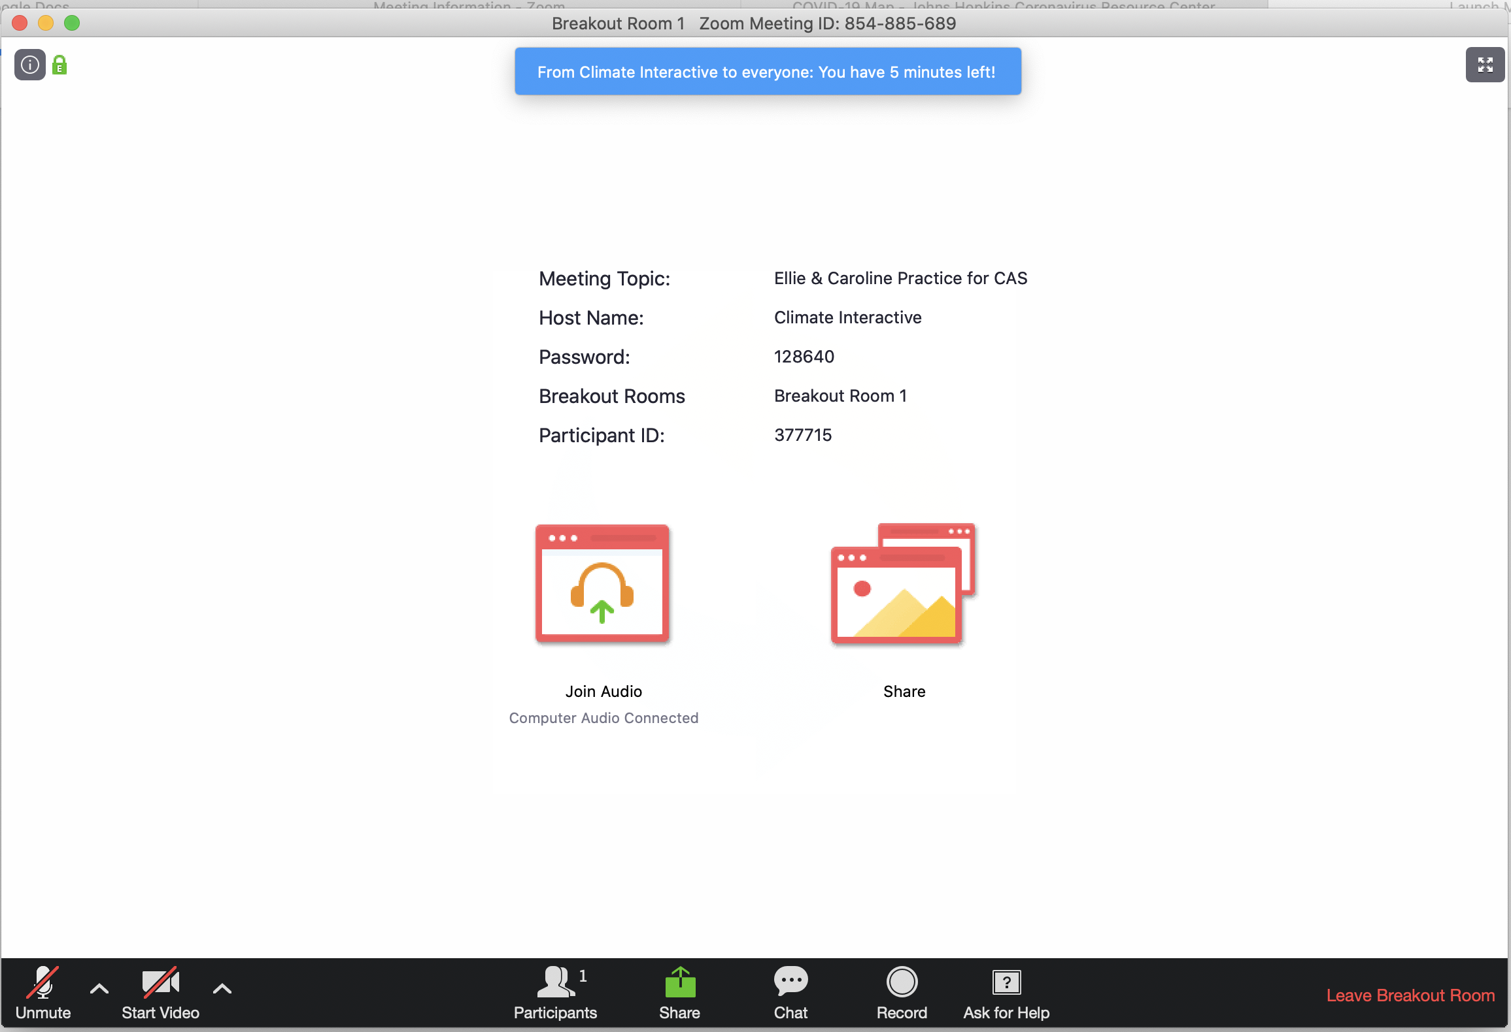
Zoom – “Breakout Room” Interface
Keep an eye out for a message from your host during your breakout session
Use the “Leave Breakout Room” button if you need to return to the main room
Use the “Ask for Help” button if you have a question for a host

